Slide 1

Fluvanna Leadership
Development Program
Presentation to Board of Supervisors
December 19, 2018
“I know no safe depository of the ultimate powers of the society but the people themselves; and if we think them not enlightened enough to exercise their control with a wholesome discretion, the remedy is not to take it from them, but to inform their discretion with education.”
– Thomas Jefferson

Slide 2
Purpose of FLDP
For aspiring leaders & the “just curious” citizens of Fluvanna, this program is designed to:
Educate about county operation, issues & challenges
Encourage service on boards & commissions or in elective office
Strengthen support for volunteer organizations
Increase broader and more effective citizen involvement in the Fluvanna community

Slide 3
Backed by the Community
Founded 16 years ago to meet challenges of growth and change for the county
Sponsored/Supported by Fluvanna Board of Supervisors
Affiliated with Virginia Cooperative Extension Service
Assisted by county officials, business leaders and volunteer organizations throughout the county

Slide 4
FLDP Steering Committee
Program is governed by a steering committee of 20-25 members, all graduates of the program
Our strength is in collaborative planning & execution to improve the program each year
Leadership succession plan ensures both institutional continuity and regular infusion of new ideas
Program is managed 100% by volunteers!

Slide 5
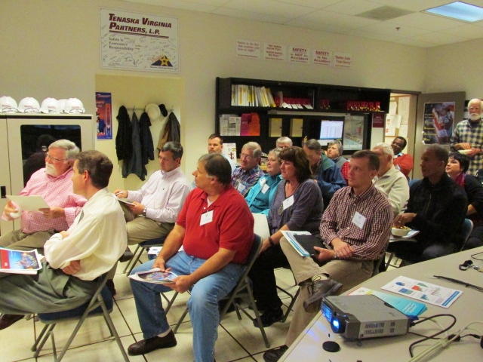
What They Learn
FLDP provides demanding education in how Fluvanna functions:
  Biweekly Sessions Sept.-April
  Speakers are key County staff and leaders in business and volunteer organizations
  Meet in public & business locations across the county
  Thorough non-partisan study of current county issues
  Q & A period in each session

Slide 6
Improvements for 2018-19
Continued “get acquainted” kickoff session to improve interaction among students and with Steering Committee
Continuous updates to website to improve communication with both public and students
Launching an FLDP Alumni Group to encourage continuing service to the county
Registration and payment available online; 75% of applicants took advantage of online registration and payment through PayPal
Improved & expanded introductory day-long bus tour

Slide 7
Class 16 Capstone Projects
Student groups work to develop plans for projects of value to the community
Improving the Farmers Market in Fluvanna
Bandstand Roof (stage at Pleasant Grove Park)
History Exhibits Accessibility/Oral History
Developing Youth Opportunities in Fluvanna

Slide 8
Members of Class 16
28 participants are expected to graduate this year:
Average age is younger than other recent classes
Includes several married couples, a school board member, and a county employee
Good geographic representation of the county
Outstanding backgrounds & experiences
Registration exceeded expectations; created a wait list for Class 17

Slide 9
Measuring Our Success
What have over 333 FLDP graduates done for Fluvanna?
To date, graduates have held more than 250 positions in governmental elected, staff & appointed positions
Graduates offer volunteer service and leadership in countless Fluvanna civic, community service and religious organizations
Student projects have provided services and ideas to augment those of the County including the recently formed PARC

Slide 10
Major Boards and Commissions
FLDP Graduates Currently Serve On:
Board of Supervisors: 3 out of 5 are graduates
Planning Commission: 3 out of 6 are graduates
Economic Development Authority: 3 out of 8
Fluvanna School Board: 1 grad, 1 current student out of 5
Board of Zoning Appeals: 3 out of 5 are graduates
Partnership for Aging: 4 out of 8 are graduates
Economic Development & Tourism: 4 out of 10 are grads
Palmyra Beautification (PARC), 4 out of 5 are graduates
We’re also proud that two of our five constitutional officers and the county administrator are FLDP alums

Slide 11
Financial Overview:
Funding from BOS in 2018-2019 : $1000
Enrollment fee of $50 was not increased from previous year
Expenses include:
  Full-day bus tour of the county including lunch at FUMA
  Graduation dinner for participants and guest speakers
  Light refreshments at each session
  Replacement of office supplies
  Committee members background checks for Extension Service
  Scholarships for persons who cannot afford enrollment fee

Slide 12
Request to Board of Supervisors
  This year’s program operated on budget and maintained a conservative cushion for unexpected expenses
  FLDP has no paid staff and meeting spaces are free of charge, thanks to the generosity of our community
  Financial records are examined by an outside auditor at the end of each program year.
We ask that you continue 0perational funding of $1,000 for 2019-2020

Slide 13
Thank You !

