Slide 1
21st Century Budgeting for Public Safety – Law Enforcement
Fluvanna Sheriff’s Office…
Working Hard to Keep You Safe

Slide 2
FCSO Pillars of 21st Century Policing
Building Trust and Legitimacy
Policy and Oversight
Technology and Social Media
Community Policing and Crime Reduction
Training and Education
Officer Wellness

Slide 3
Fluvanna County Sheriff’s Office Safe Community Initiatives
Business Watch
Project Lifesaver
Child ID
Safe Exchange Program
Community Event Notification

Slide 4
Business Watch
Increase communication between law enforcement, business owners, managers, and supervisors
Help build a safer environment for both the employee and your consumers
Built around three different elements

Slide 5
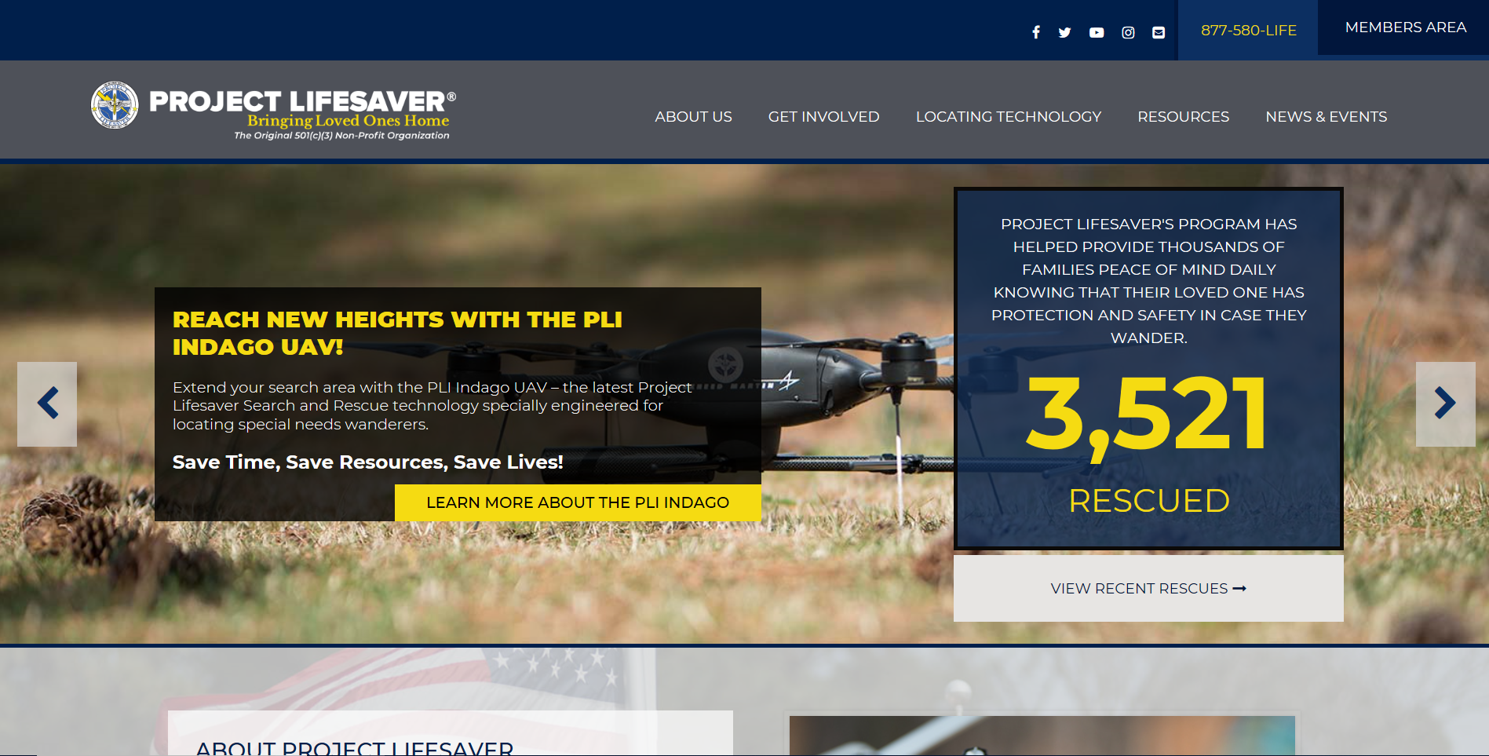
Project Lifesaver

Slide 6
Project Lifesaver
The Fluvanna Way
SGT Barbara Henson and Deputy Kevin Taylor are our field service officers. They service each unit and replace the batteries in them monthly.

Slide 7
Fluvanna Child ID Program
Brought to you by:
Fluvanna County Sheriff’s Office, in collaboration with Commonwealth Attorney’s Office, and Fluvanna Rotary Club

Slide 9
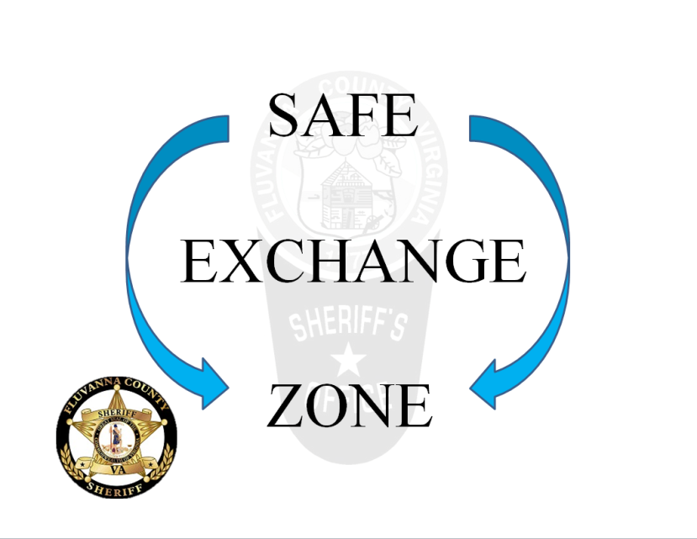
Safe Exchange Zone
The “Safe Exchange Zone” is a designated area where those exchanges can be made knowing the safety of the Sheriff’s Office is just a few steps away, if needed. The “Safe Exchange Zone” is available 24 hours a day and is used on a first come, first served basis.

Slide 10
Community Event Notifications
Webform

Slide 11
Call Volume-Emergency Communications Center

Slide 12
Work Load

Slide 13
Civil Process and Enforcement

Slide 14
Judicial Case Load Increasing
State Compensation Board Request
Due to the amount of local case load courts have added additional courts days in each court.
Circuit Court will be adding a new judge.
Need to the two deputies requested to mitigate staffing gaps with the changes and increase to workload, as State Compensation Board assessed.

Slide 15
Balanced Fleet for Calls for Service

Slide 16
The Cockpit of our Police Cars -FULL

Slide 17
Thank you for your time!
Help us provide the level care the Fluvanna Community needs and deserves.

