Slide 1
ZMP 24:02 BHL Group LLC, et al Rezoning Request
Tuesday, June 11, 2024
Todd Fortune
Director of Planning

Slide 2
ZMP 24:02 BHL Group Rezoning Request
ZMP 24:02
BHL Group LLC, et al
A request to amend the Fluvanna County Zoning Map to rezone 4.125 acres of Tax Map 5 Section A Parcel 22 from A-1, Agricultural, General to I-1, Industrial, Limited. The property is located on Better Living Drive and is in the Zion Crossroads Community Planning Area and the Columbia Election District.

Slide 3
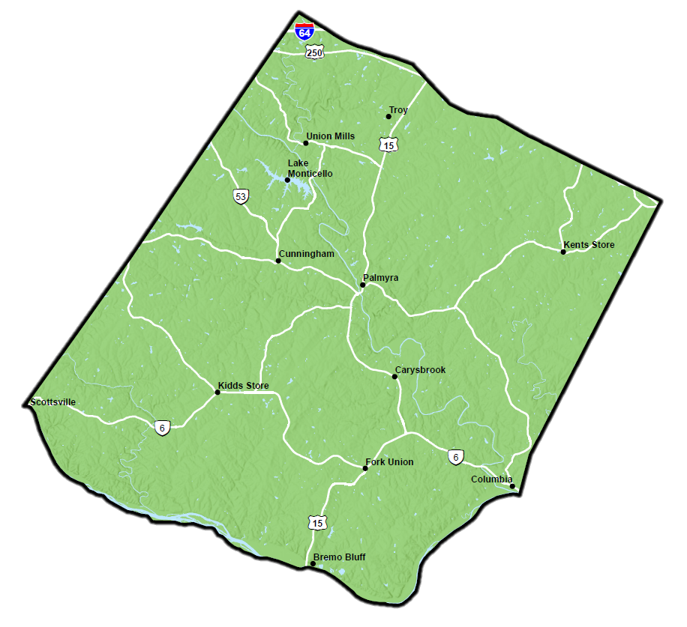
BHL Group LLC Site Location

Slide 4
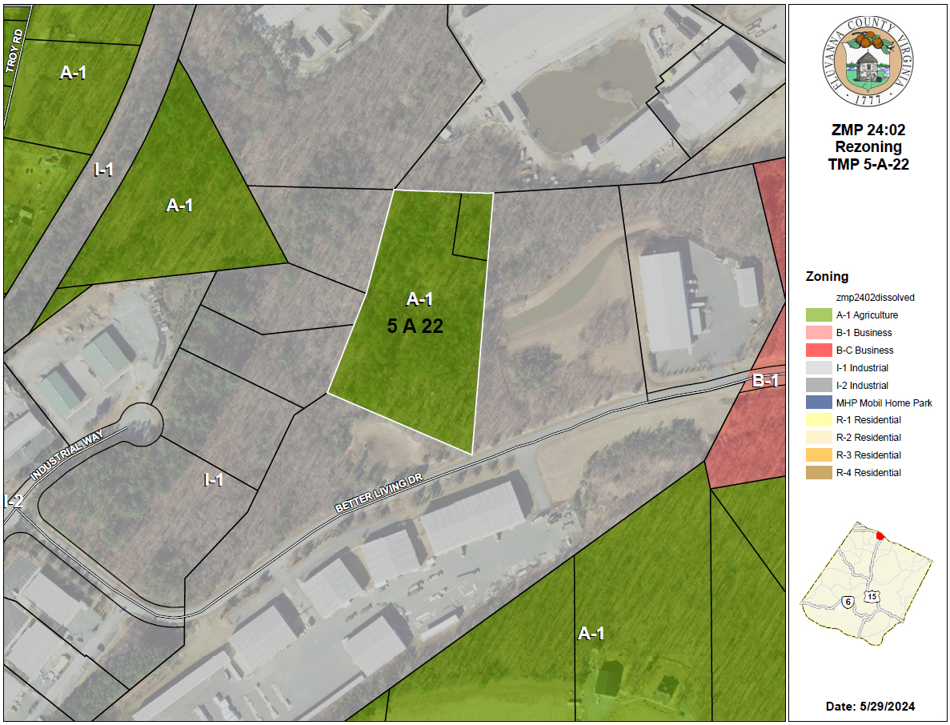
BHL Group Parcel Map

Slide 5
BHL Group LLC Rezoning Request - Background
Property located in the Zion Crossroads Industrial Park.
Property currently zoned A-1, Agricultural, General.
All surrounding properties are zoned I-1, Industrial, Limited.
The owners had requested a Boundary Line Adjustment (BLA) for the parcel in question. The BLA is needed to provide for road access. Currently, only one corner of the lot touches the road. The BLA would allow for adequate road frontage.
Since this parcel is zoned differently from surrounding parcels, a BLA is not currently allowed. The rezoning is necessary to allow for the BLA.

Slide 6
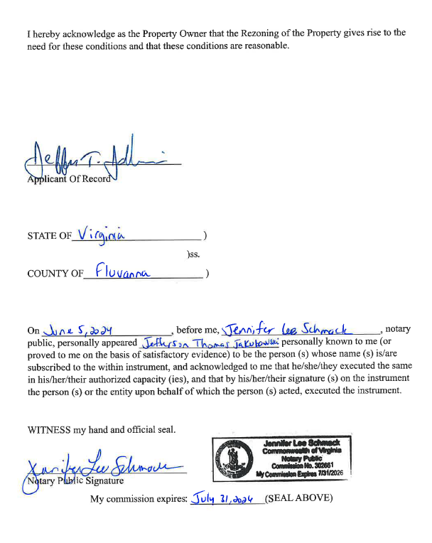
BHL Group Proffer – Signed Statement

Slide 7
BHL Group LLC Rezoning Request – Background (cont.)
The Technical Review Committee has reviewed this request. None of the Committee members expressed any concerns over the rezoning. A few of the committee members noted that when the property is developed, some coordination will be needed with various departments/agencies:
Fluvanna County Public Utilities: Advised that if/when the owner has something built on the property, there may need to be a discussion about utility hookups.
Fluvanna County Building official: Advised that if/when the owner has something built on the property, permits will need to be addressed at that time.
Virginia Department of Health: The only issues they would have pertain to water/sewer hookups if/when the property is developed.
VDOT: When a site plan is submitted for development of the property, make sure the plans meet all applicable VDOT requirements.

Slide 8
Compliance with Comprehensive Plan
The subject property is located in the Zion Crossroads Community Planning Area. This area is envisioned to be the most intensely developed part of the county, consisting of regional mixed-use, regional employment, and neighborhood mixed-use developments. This area is the county’s primary regional economic development area and is targeted as a regional employment center with primarily mixed-use, mixed-income development.

Slide 9
Applicant Presentation
ZMP 24:02 BHL Group Rezoning Request

Slide 10
Public Hearing (with 5 minutes per speaker)
ZMP 24:02 BHL Group Rezoning Request

Slide 11
Planning Commissioners Discussion
ZMP 24:02 BHL Group Rezoning Request

Slide 12
ZMP 24:02 Planning Commission Motion
I move that the Planning Commission recommends (approval / denial / deferral) of ZMP 24:02, a request to amend the Fluvanna County Zoning map to rezone 4.125 acres of Tax Map 5 Section A Parcel 22 from A-1, Agricultural, General to I-1, Industrial, Limited subject to the revised proffers dated June 5, 2024.

