Slide 1
Amendment of §§ 22-17-7 and 19-9-6 to amend zoning and subdivision fees
Tuesday, July 9, 2024
Todd Fortune
Director of Planning

Slide 2
Amendment of Zoning and Subdivision Fees
This is a request to amend the Fluvanna County Code to amend § 22-17-7 - Schedule of zoning fees – and § 19-9-6 - subdivision fees

Slide 3
Background
Zoning and Subdivision fees were last adjusted in 2018.
These changes would bring Fluvanna County in line with surrounding counties.
The overall effect is that amending the fees could potentially increase revenue ~ $25,000.

Slide 4
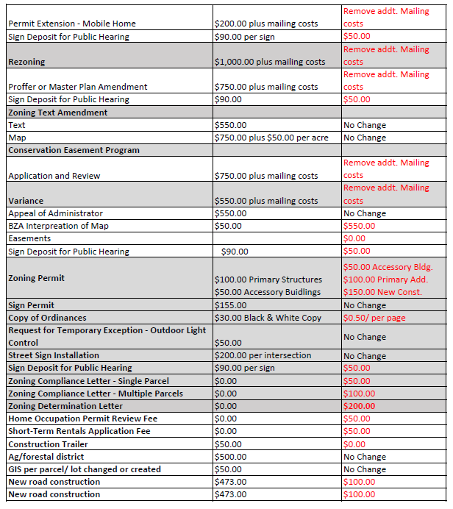
Proposed Fee Changes

Slide 5
Public Hearing (with 5 minutes per speaker)
Amendment of Zoning and Subdivision Fees

Slide 6
Planning Commissioners Discussion
Amendment of Zoning and Subdivision Fees

Slide 7
Planning Commission Motion
I move that the Planning Commission recommends (approval / denial / deferral) of an ordinance to amend §§ 22-17-7 and 19-9-6 of the Fluvanna County Code to amend zoning and subdivision fees

