Slide 1
Amendment to Planning Commission Bylaws to Change Meeting Location
Tuesday, July 9, 2024
Todd Fortune
Director of Planning

Slide 2
Bylaws Amendment - Background
The Planning Commission Bylaws were last amended in February 2024.
At the time, Planning Commission meetings were held at the Carysbrook Performing Arts Center. The current Planning Commission Bylaws state that meetings are to be held at this location.
Starting in June, Planning Commission meetings were moved to the Morris Room, of the County Administration Building.
The Planning Commission Bylaws (Page 1) need to be amended to account for the change in meeting location.

Slide 3
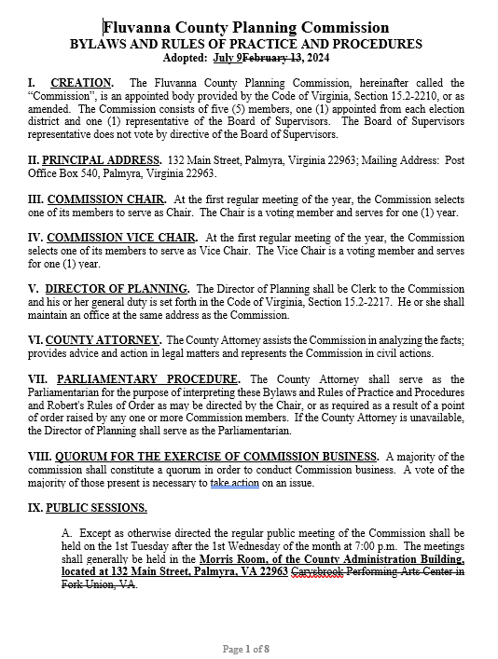
Bylaws Amendment – Proposed Change

Slide 4
Planning Commissioners Discussion
ZMP 24:01 Rai Proffer Amendment Request

Slide 5
ZMP 24:01 Planning Commission Motion
I move that the Planning Commission (approve / deny) an amendment to Page 1 of the Planning Commission Bylaws to change the location of Planning Commission meetings to the Morris Room, of the County Administration Building.

