Slide 1
SDP 24:04 S.B. Cox, Inc. Site Development Plan
Tuesday, July 9, 2024
Todd Fortune
Director of Planning

Slide 2
SDP 24:04 S.B. Cox, Inc. – Background
S.B. Cox Inc. has submitted a Site Development Plan for a materials recovery facility for construction and demolition debris on an approximately 16-acre portion of Tax Map 4 Section A Parcel 27A.
A Special Use Permit (SUP) was approved for the property in February 2023.
The entire property is currently zoned I-2, General Industrial and contains a total of ninety (90) acres and is currently owned by Amber Hill, LLC.
The SDP being considered is for a facility on Lot 3, consisting of approximately 16 acres. The remainder of the property would be retained for future development as an industrial park.

Slide 3
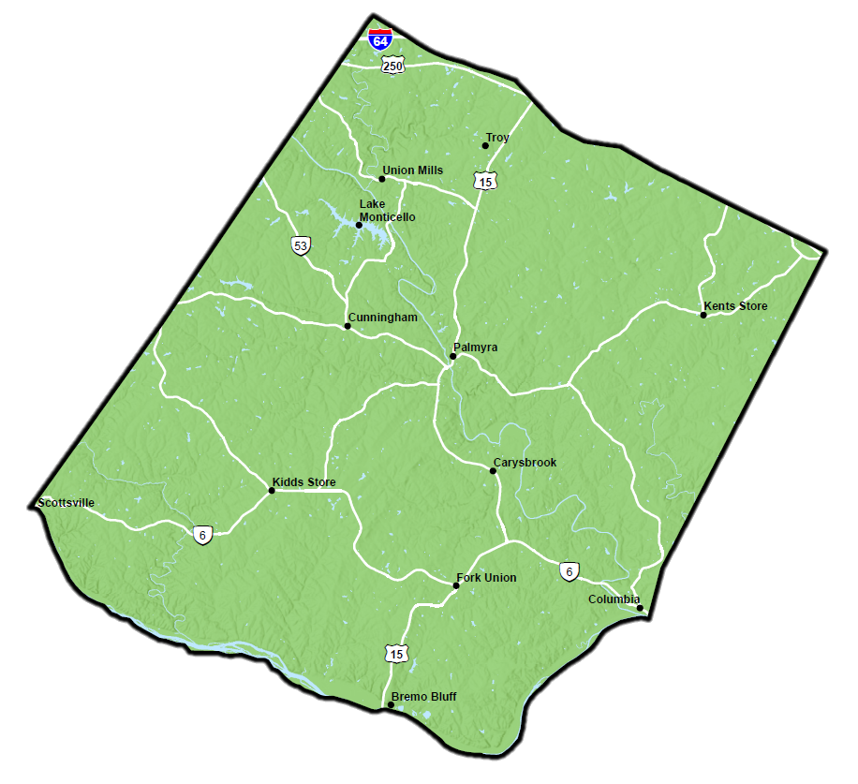
S.B. Cox, Inc. Site Location

Slide 4
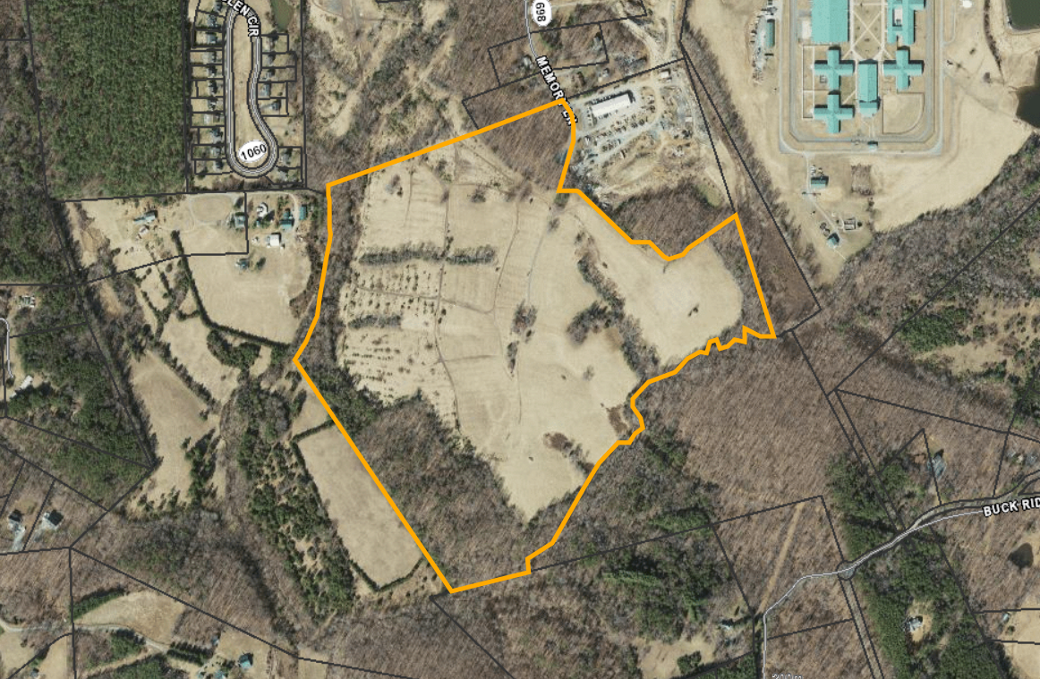
S.B. Cox, Inc. Parcel Map

Slide 5
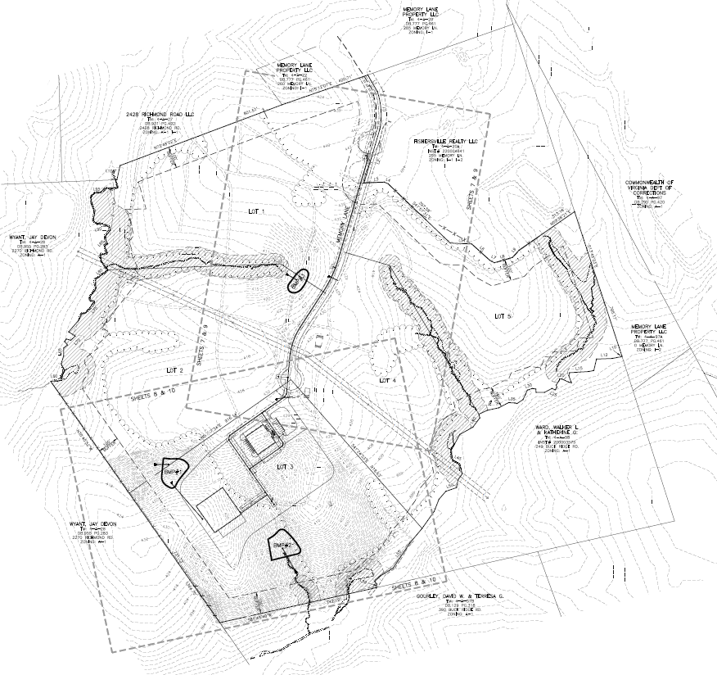
S.B. Cox, Inc. Parcel – Lot Layout
Lot 3

Slide 6
SDP 24:04 S.B. Cox, Inc. – Background cont.
The Fluvanna County Zoning Ordinance defines a Solid waste material recovery facility as a solid waste management facility which may receive municipal solid waste and recyclables from off premises for processing and consolidation and shipment out of the County for further processing and disposal. (Zoning Definitions 22-22-1).
The applicant’s proposed materials recovery facility use would be limited to construction and demolition debris. Other inert materials and hazardous waste will not be transported to the Site.
The applicant currently owns and operates materials recovery facilities in Richmond and Yorktown. Due to high demand and industry needs, the applicant is seeking to establish a third facility and plans to expand its operations onto this existing general industrial property in Fluvanna County.

Slide 7
SDP 24:04 S.B. Cox, Inc. – Background cont.
The Board of Supervisors approved the SUP on February 15, 2023 subject to 11 conditions as recommended by the Planning Commission:
1. The administrative site development plans will be in substantial conformance with the Preliminary Site Plan prepared by LaBella, dated October 14, 2022 and the Materials Recovery Facility Plan, prepared by LaBella, dated October 14, 2022; with both plans being subject to final engineering and revisions necessary to meet both the requirements of these Special Use Permit conditions and as otherwise required by law, such as VDEQ, VDH and VDOT requirements.
2. The applicant shall inspect and record Memory Lane prior to site construction and VDOT will need in writing that the applicant is responsible to repair all damages done to Memory Lane (SR 698) during site construction as well as having that as a part of their approved site development plans.
The applicant shall construct or bond for construction the site entrance(s) to the proposed facilities to meet VDOT entrance and intersection requirements prior to the issuance of a Zoning Permit. The applicant shall notify VDOT and Fluvanna County in writing prior to commencing any construction or logging activity on the Site.
4. A Traffic Management Plan for the materials recovery facility use shall be provided to VDOT and Fluvanna County for site development plan review and approval purposes.

Slide 8
SDP 24:04 S.B. Cox, Inc. – Background cont.
5. A minimum one hundred (100) foot buffer shall be maintained along all property lines that adjoin agricultural, residential or business districts. Land clearing is not permitted within this buffer area, except for the removal of dead or diseased vegetation and/or maintenance purposes. The applicant shall meet the required Zoning Ordinance buffer and screening requirements by supplementing the existing screening materials to the reasonable satisfaction of the Zoning Administrator.
6. The applicant will only accept construction or demolition waste and other inert materials with the sole intent to be recycled and all other solid waste will be transported outside of Fluvanna County to an approved sanitary landfill location.
7. The applicant will operate the materials recovery facility Monday through Friday, from 6:00 am to 6:00 pm and on Saturday from 6:00 am to Noon; with no Sunday operations.
8. The applicant will be responsible for compliance with the Fluvanna County lighting and noise ordinance requirements, that are amended from time to time.
9. The site shall be maintained in a neat and orderly manner so that the visual appearance from the public right-of-way and adjacent properties is acceptable to County officials.
10. The Board of Supervisors, or its representative, reserves the right to inspect the property for compliance with these conditions at any time, upon reasonable notice.
11. Under Section 22-17-4 F (2) of the Fluvanna County Code, the Board of Supervisors has the authority to revoke a Special Use Permit if the property owner has substantially breached the conditions of the Special Use Permit.

Slide 9
SDP 24:04 S.B. Cox, Inc. – Background cont.
The Technical Review Committee reviewed the Preliminary Site Plan on October 27, 2022. Staff sent the Site Development Plan to the TRC on June 5, 2024 for review and asked the group if they needed to meet again to discuss. The consensus of the TRC was that there was no need to meet again. Individual TRC members had the following comments:
VDH-ODW – It appears that they are proposing an onsite septic system. The onsite system needs to be designed by a private onsite soil evaluator and must be signed off by a waste water engineer/PE and submitted to the local health department (it appears from the site plan that the facility will connect to the existing water system in the area).
Fluvanna County Building Inspector – From the Building Inspection Department we can do all of our compliance once the building set of plans is applied for.
Fire/Rescue: It appears that the Cul-De-Sac is 100' Diameter, hydrants are in good locations and access for fire apparatus is good. Just a reminder, the fire hydrants need to have National Standard Threads.

Slide 10
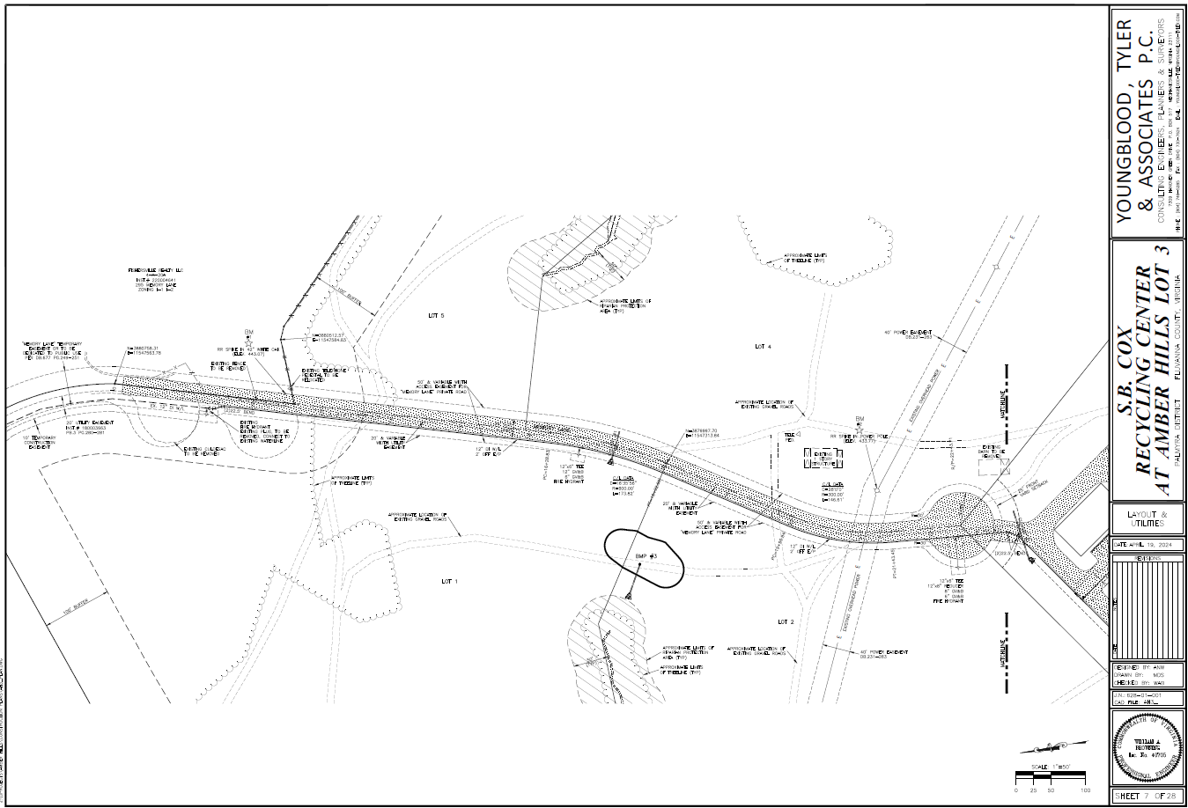
S.B. Cox, Inc. Site Development Plan – Page 7

Slide 11
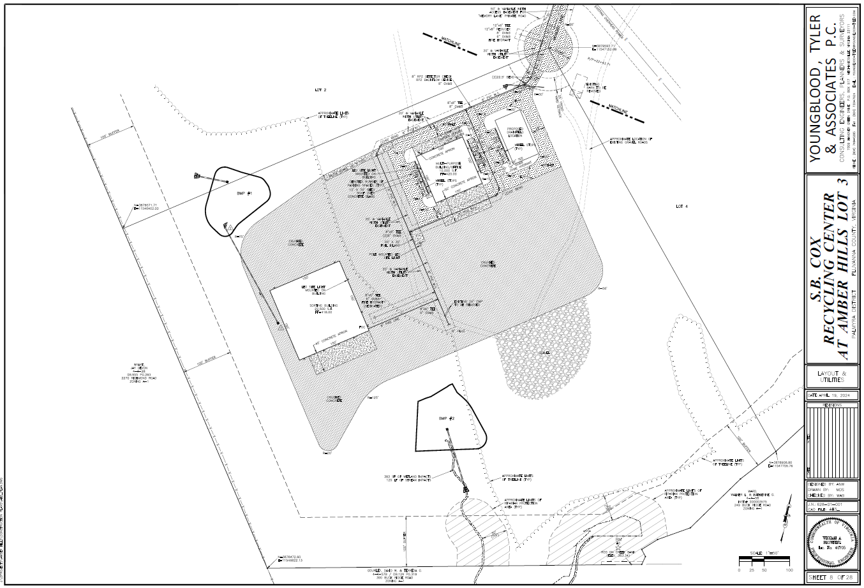
S.B. Cox, Inc. Site Development Plan – Page 8

Slide 12
Planning Commissioners Discussion
SDP 24:04 S.B. Cox, Inc

Slide 13
SDP 24:04 Planning Commission Motion
I move that the Planning Commission (approve / deny / defer) SDP 24:04 S.B. Cox Inc., a Site Development Plan request for a solid waste material recovery facility with respect to 16 acres +/- of Tax Map 4 Section A Parcel 27A.

