Slide 1
Comprehensive Plan Update Planning Commission Tuesday, December 10, 2024 Todd Fortune Director of Planning

Slide 2
Comprehensive Plan – Status of Plan Update
Staff are collecting data for updates to sections of the Plan that are data intensive.
Staff are working on identifying locations for Community Meetings. There will be one for each district.
Columbia: Columbia Baptist Church
Cunningham: Antioch Baptist Church
Fork Union:
Palmyra:
Rivanna:
The target time period for these meetings is mid-to late January/early February.

Slide 3
Comprehensive Plan – Community Meetings
Community Meetings will consist of the following components:
Brief presentation by staff about the Comp Plan – what it is, why it’s important, and the process for updating the Plan.
Attendees will be broken into groups for interactive exercises:
Mapping exercise.
PARK (Preserve, Add, Remove, Keep out) exercise.

Slide 4
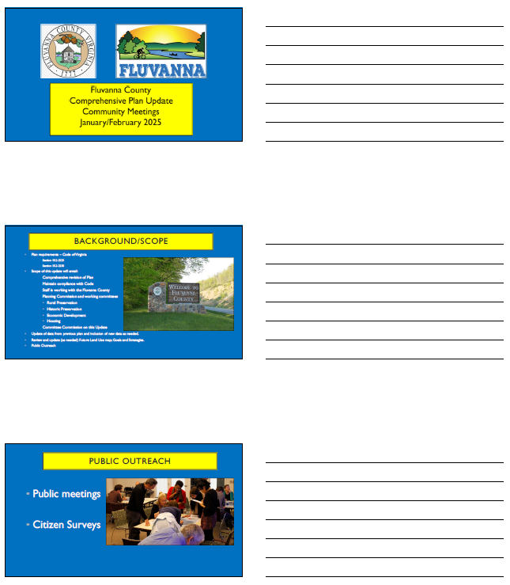
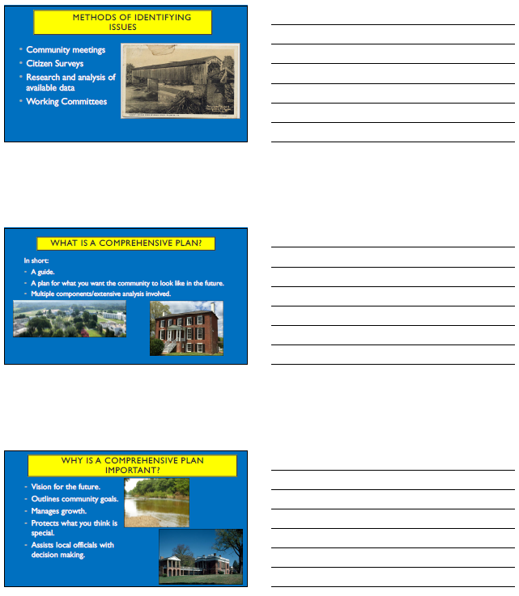
Comprehensive Plan – Community Meetings
Community Meeting Presentation

Slide 5
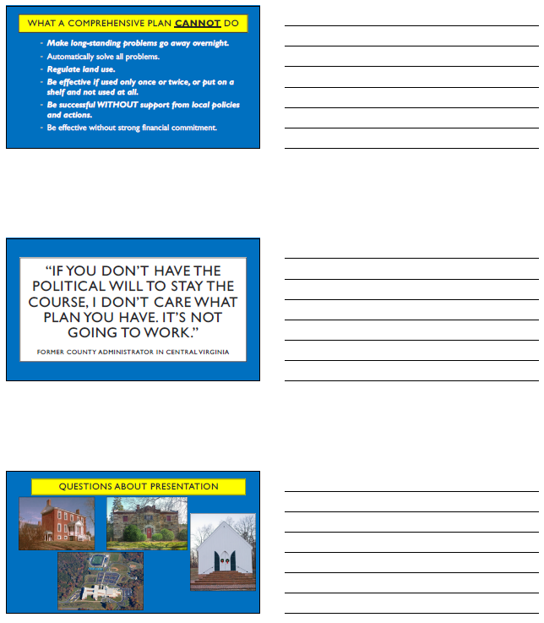
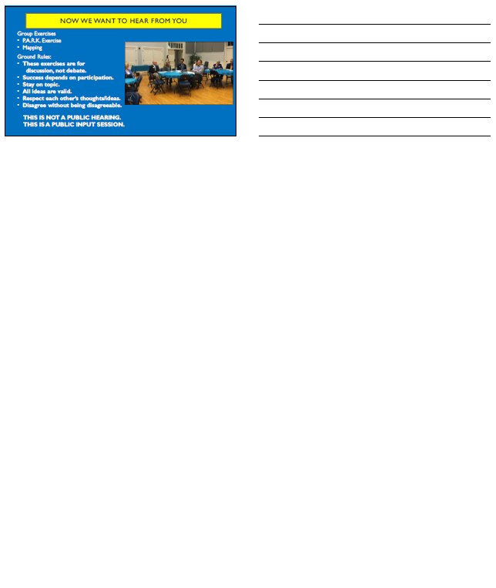
Comprehensive Plan – Community Meetings
Community Meeting Presentation

Slide 6
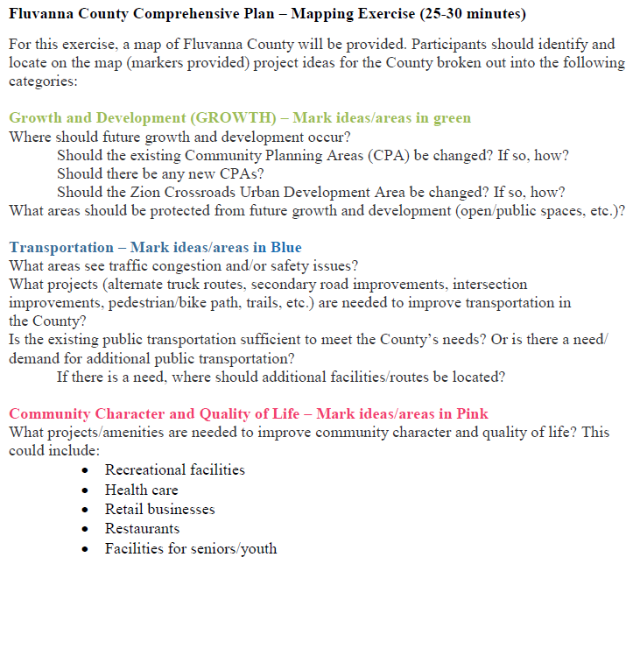
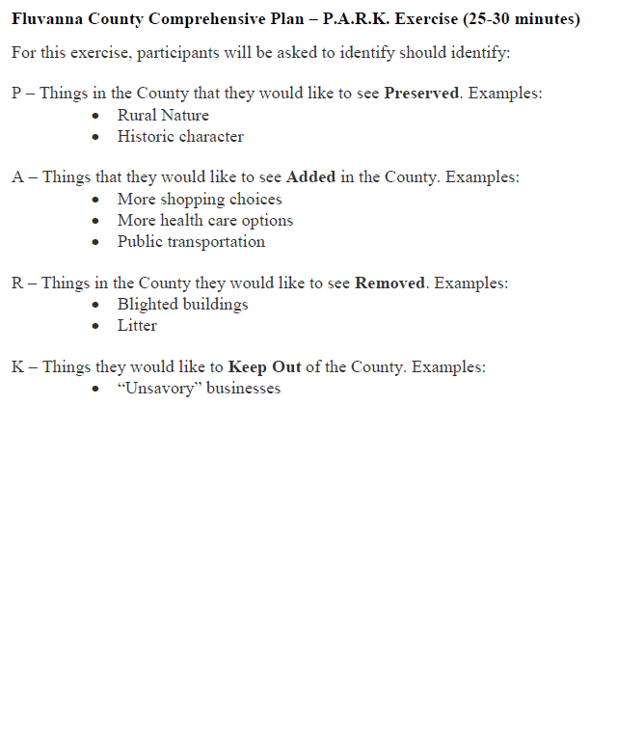
Comprehensive Plan – Group Exercises
Exercise Worksheets

Slide 7
Comprehensive Plan – Advisory Groups
Per guidance from the Planning Commission, the following advisory groups are being restarted/created to assist with the update of the Plan:
Rural Preservation (existing)
Historic Preservation (existing)
Housing (new)
Economic Development (new)
Staff have reached out to members of the existing committees to gauge their interest in continuing to participate in their respective committees.
Staff have reached out to the community through the County web site and Fluvanna Fan Mail to solicit interest.
Staff will also be sending an announcement to the Fluvanna Review for publication.
The deadline for applications to serve on an advisory group is January 7, 2025.

Slide 8
Comprehensive Plan – Census Data
A brief comment about Census data:
The 2020 Decennial Census has issues with reliability.
One example has to do with the Town of Farmville (Prince Edward County) – specifically, a Census block with no homes which is showing a population of more than 500.
When possible, other sources will be used for demographic data.
In addition to the Decennial Census, the U.S. Census Bureau has an American Community Survey that provides 1-year and 5-year averages using a smaller sample size.
We will also work with the Weldon Cooper Center on collecting data.

Slide 9
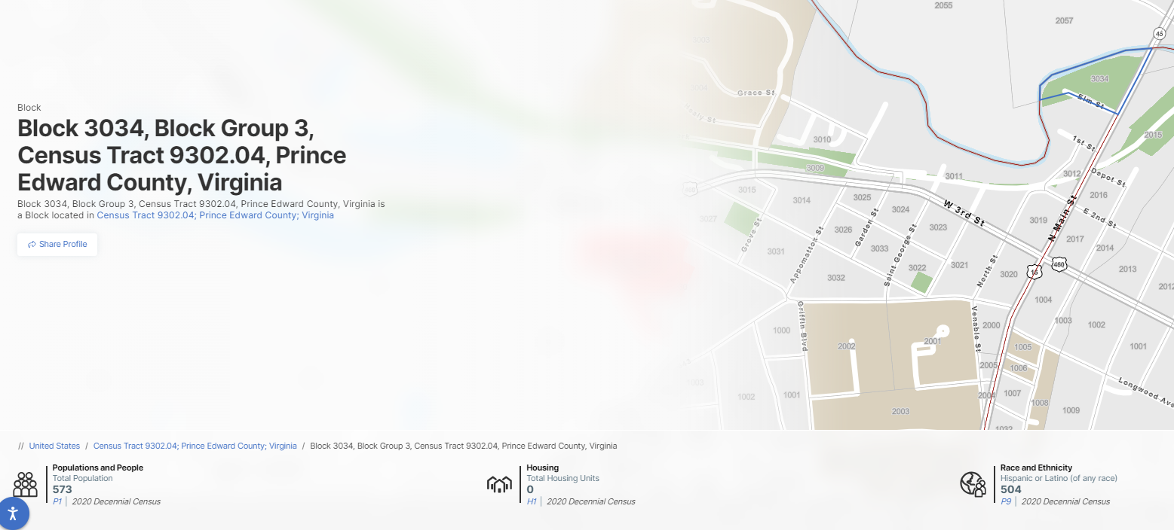
Comprehensive Plan – Census Data
This block includes the following:
A small portion of Green Front Furniture (a local business).
A parking lot.
Riverside Park (owned by the Town of Farmville).

Slide 10
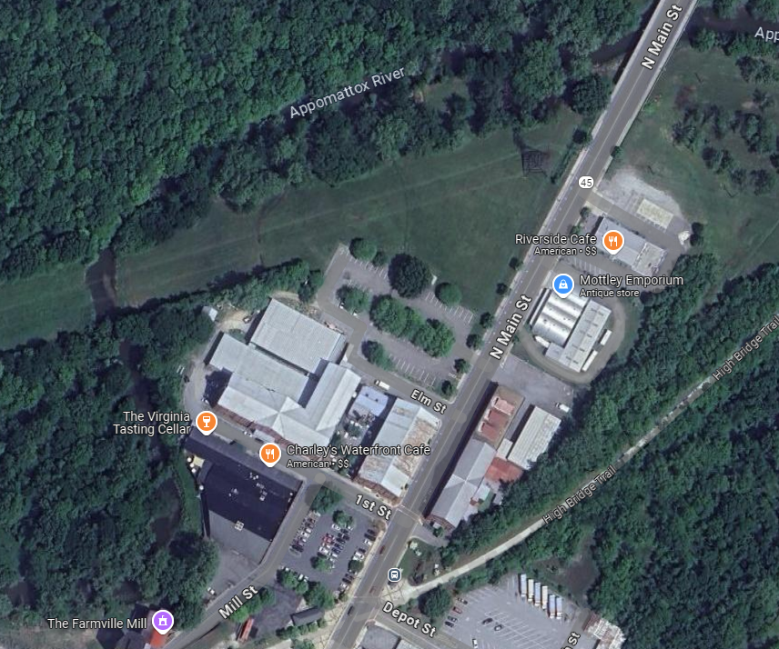
Comprehensive Plan – Census Data
Riverside Park
Geenfront Furniture
Upon investigating this block, it was determined that the Census Bureau “injected noise” into this block to come up with a population number (other blocks may have experienced the same thing).

