Slide 1
Zoning Text Amendment
Subdivision Definitions
Planning Commission
December 10, 2024
Todd Fortune
Director of Planning

Slide 2
ZTA – Subdivision Definitions
This proposed ZTA would amend the Fluvanna County Code by amending § 22-22-1 to add a definition for parent tract and to amend the definition of minor subdivision to clarify that no more than five lots may be created from the parent tract using the minor subdivision approval process, regardless of whether the lots are created at one time or over an extended period of time.
Fluvanna Code currently allows parcels to be repeatedly resubdivided every five years, using the less rigorous minor subdivision approval process and resulting in what are effectively major subdivisions. This text change eliminates the existing work-around.

Slide 3
ZTA – Subdivision Definitions
The Planning Commission will hold a public hearing tonight on amending § 19-2-1 of the Fluvanna Code to eliminate the five-year resubdivision work-around. This amendment makes the same changes in the definitions for “parent tract” and “minor subdivision” for Chapter 22, Zoning, of the Fluvanna Code.
County staff is seeking authorization to advertise for a public hearing on the proposed amendments.
The public hearing would be held during the Planning Commission meeting on January 7, 2025
The Planning Commission is being asked to approve a resolution authorizing staff to advertise a public hearing.

Slide 4
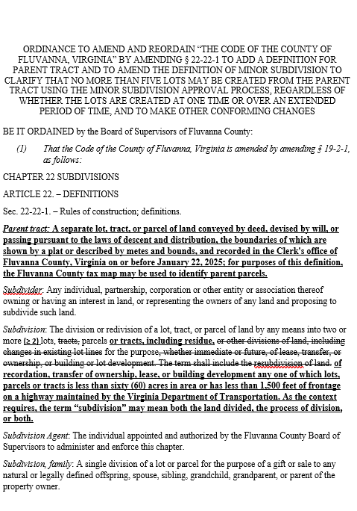
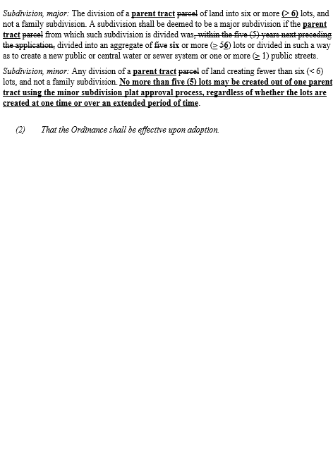
ZTA – Definition of Minor Subdivision– Ordinance

Slide 5
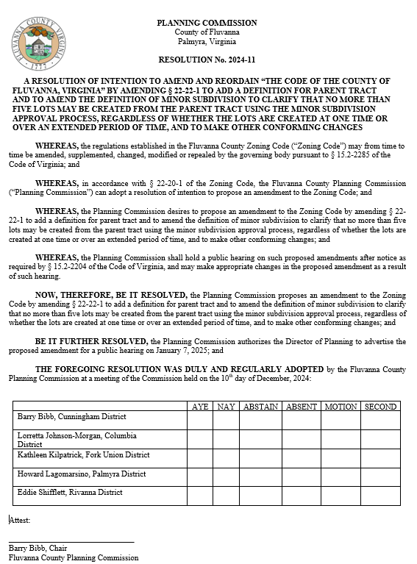
ZTA – Definition of Minor Subdivision: Resolution

Slide 6
Planning Commission Motion
I MOVE THAT THE PLANNING COMMISSION (APPROVE/ DENY / DEFER) THE RESOLUTION TO ADVERTISE A PUBLIC HEARING ON JANUARY 7, 2025 TO CONSIDER ZTA 24:11 – AN ORDINANCE TO AMEND AND REORDAIN “THE CODE OF THE COUNTY OF FLUVANNA, VIRGINIA” BY AMENDING § 22-22-1 TO ADD A DEFINITION FOR PARENT TRACT AND TO AMEND THE DEFINITION OF MINOR SUBDIVISION TO CLARIFY THAT NO MORE THAN FIVE LOTS MAY BE CREATED FROM THE PARENT TRACT USING THE MINOR SUBDIVISION APPROVAL PROCESS, REGARDLESS OF WHETHER THE LOTS ARE CREATED AT ONE TIME OR OVER AN EXTENDED PERIOD OF TIME, AND TO MAKE OTHER CONFORMING CHANGES.

