Slide 1
ZTA 24:02
Zoning Text Amendment
Fluvanna County Code § 22-4-2.2
Tuesday, June 25, 2024
Todd Fortune
Director of Planning

Slide 2
ZTA 24:02
ZTA 24:02
A request to amend § 22-4-2.2 of the Fluvanna County Code to remove utility scale solar generation facilities as a use allowed by special use permit in the agricultural, A-1 zoning district.

Slide 3
ZTA 24:02 - Background
The Solar Ordinance Review Committee has had a number of meetings to discuss policy as it relates to solar development in Fluvanna County.
  The Committee has expressed a desire to remove utility scale solar generation as an allowed use with a Special Use Permit (SUP) in the A-1 zoning district in favor of creating a new district, S-1, for the location of such facilities.
The Board of Supervisors passed a resolution on March 6 stating a desire to remove utility scale solar generation facilities as a use allowed by SUP in the A-1 district.
Consequently, a Zoning Text Amendment has been drafted to remove this use. This amendment is being presented to the Planning Commission tonight for its consideration.

Slide 4
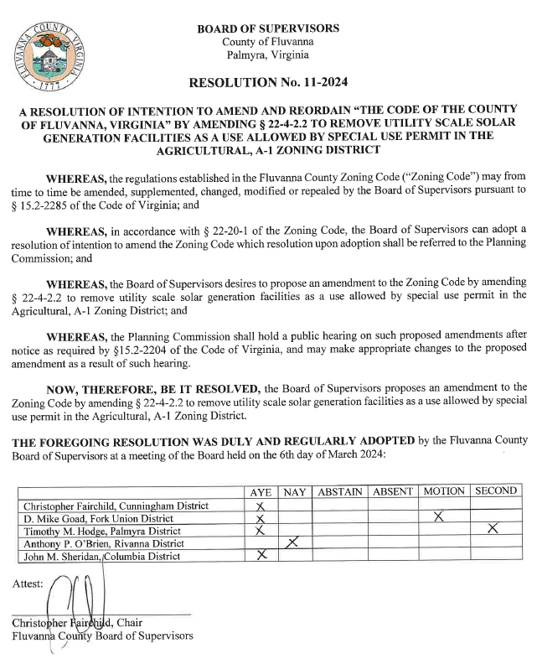
Board Resolution

Slide 5
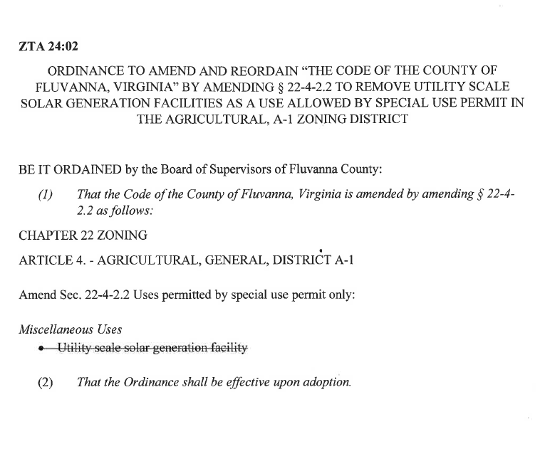
Proposed Amendment

Slide 6
Public Hearing
(with 5 minutes per speaker)
ZMP 24:02 BHL Group Rezoning Request

Slide 7
Planning Commissioners Discussion
ZMP 24:02 BHL Group Rezoning Request

Slide 8
ZTA 24:02 Planning Commission Motion
I move that the Planning Commission recommends (approval / denial / deferral) of ZTA 24:02, an amendment to § 22-4-2.2 to remove utility scale solar generation facilities as a use allowed by special use permit in the agricultural, A-1 zoning district.

