Slide 1


Fluvanna County
Comprehensive Plan Update
Community Meetings
February/March 2025

Slide 2

BACKGROUND/SCOPE
Plan requirements – Code of Virginia
Section 15.2-2223
Section 15.2-2230
Scope of this update will entail:
Comprehensive revision of Plan
Maintain compliance with Code
Staff is working with the Fluvanna County
Planning Commission and advisory groups:
Rural Preservation
Historic Preservation
Economic Development
Housing
Update of data from previous plan and inclusion of new data as needed.
Review and update (as needed) Future Land Use map; Goals and Strategies.
Public Outreach

Slide 3

PUBLIC OUTREACH
Public meetings
Citizen Surveys

Slide 4
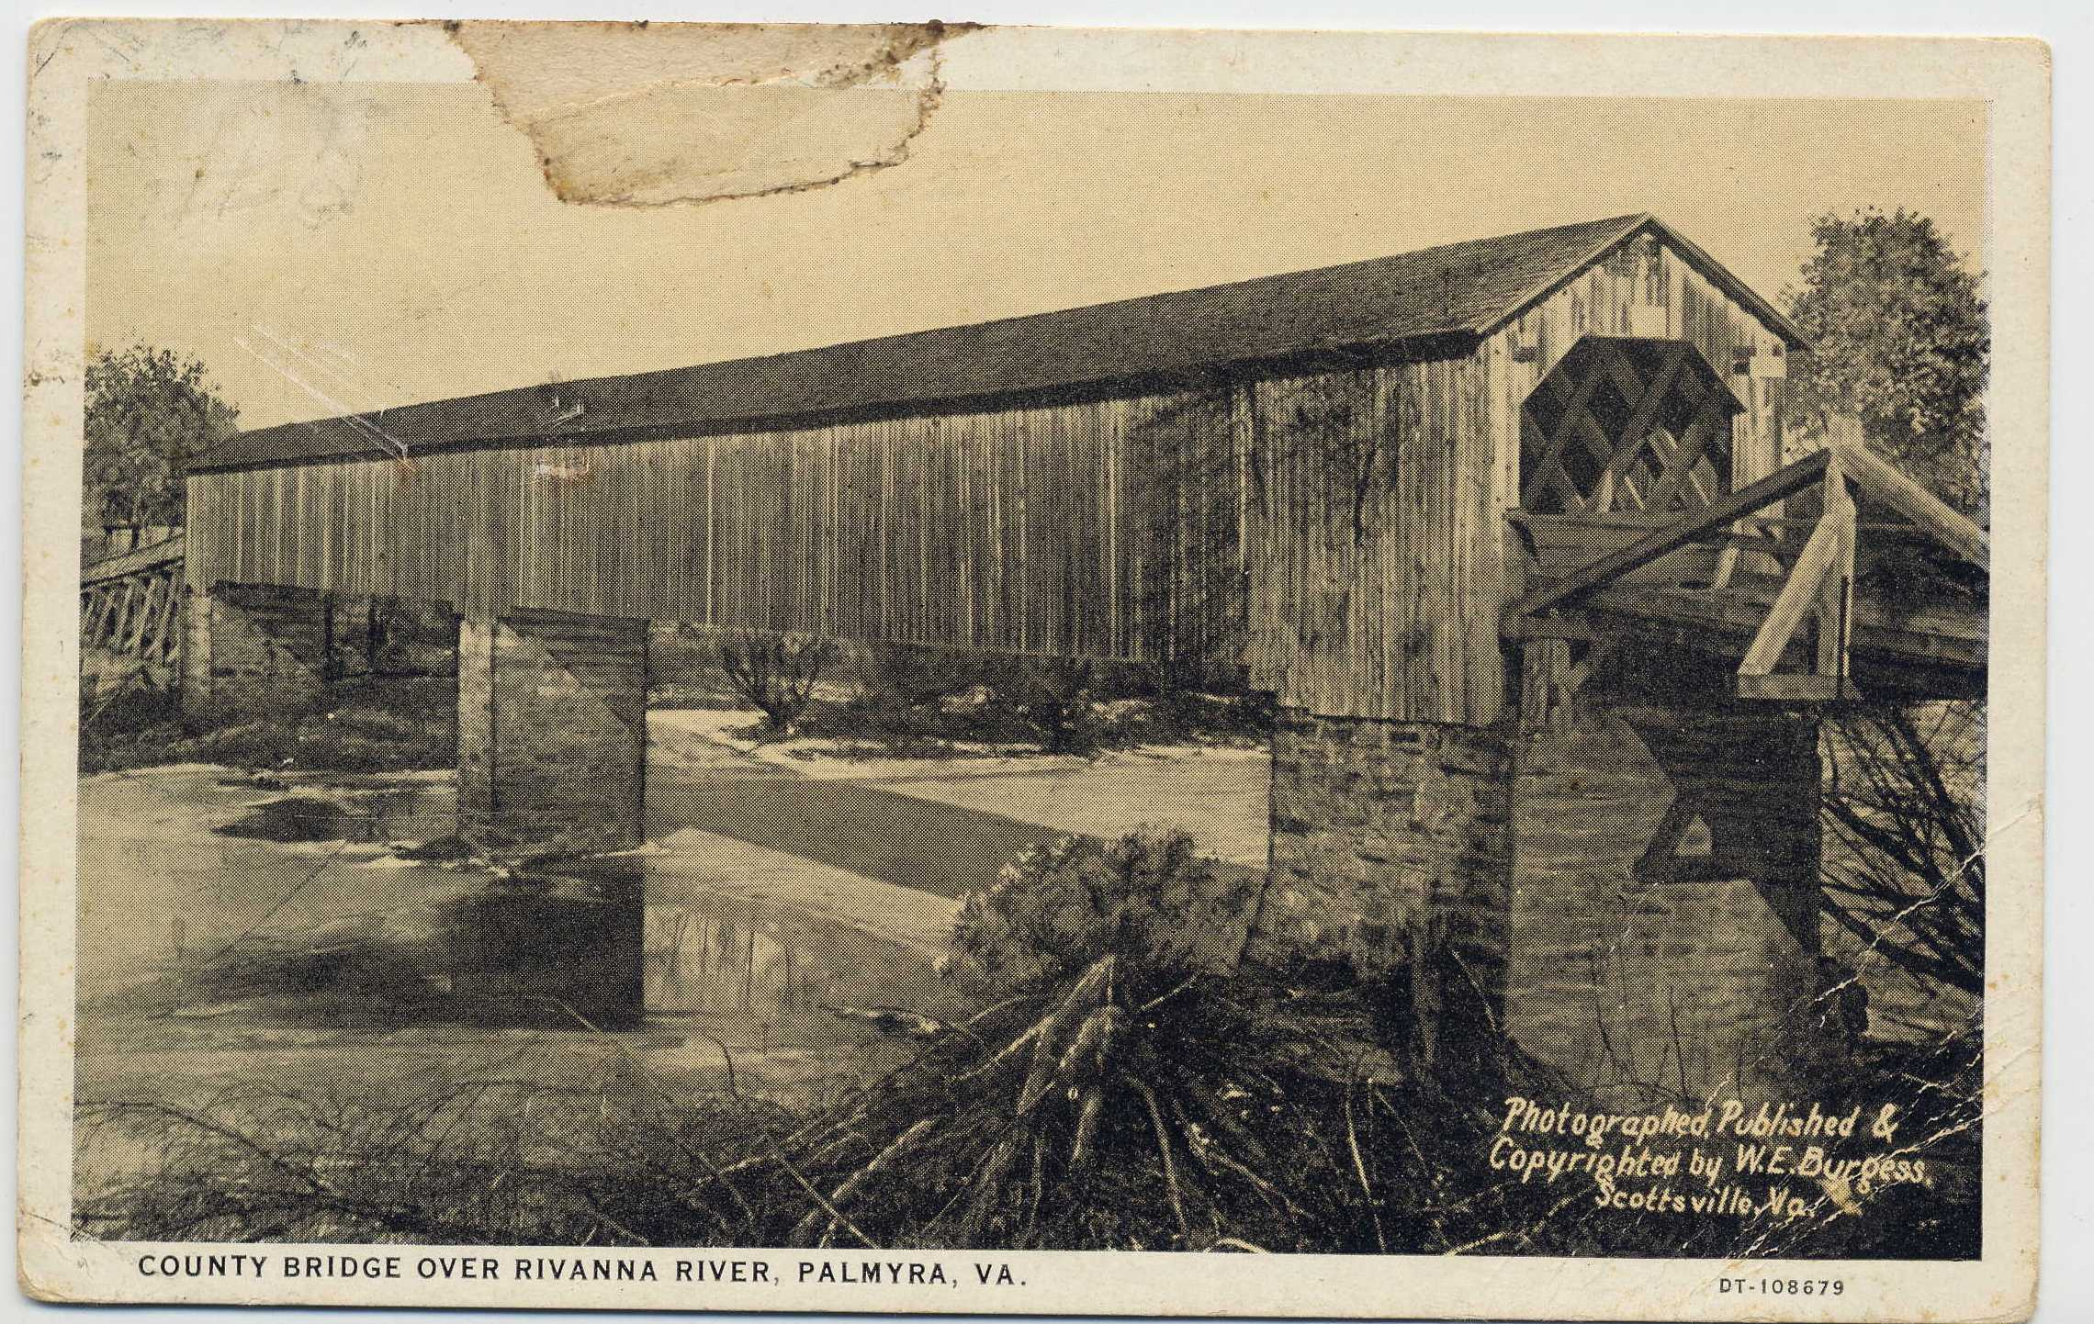
METHODS OF IDENTIFYING ISSUES
Community meetings
Citizen Surveys
Research and analysis of available data
Working Committees

Slide 5


WHAT IS A COMPREHENSIVE PLAN?
In short:
A guide.
A plan for what you want the community to look like in the future.
Multiple components/extensive analysis involved.

Slide 6


WHY IS A COMPREHENSIVE PLAN IMPORTANT?
Vision for the future.
Outlines community goals.
Manages growth.
Protects what you think is special.
Assists local officials with decision making.

Slide 7
WHAT A COMPREHENSIVE PLAN CANNOT DO
Make long-standing problems go away overnight.
Automatically solve all problems.
Regulate land use.
Be effective if used only once or twice, or put on a shelf and not used at all.
Be successful WITHOUT support from local policies and actions.
Be effective without strong financial commitment.

Slide 8
“If you don’t have the political will to stay the course, I don’t care what plan you have. It’s not going to work.”
Former County Administrator in CENTRAL VIRGINIA

Slide 9
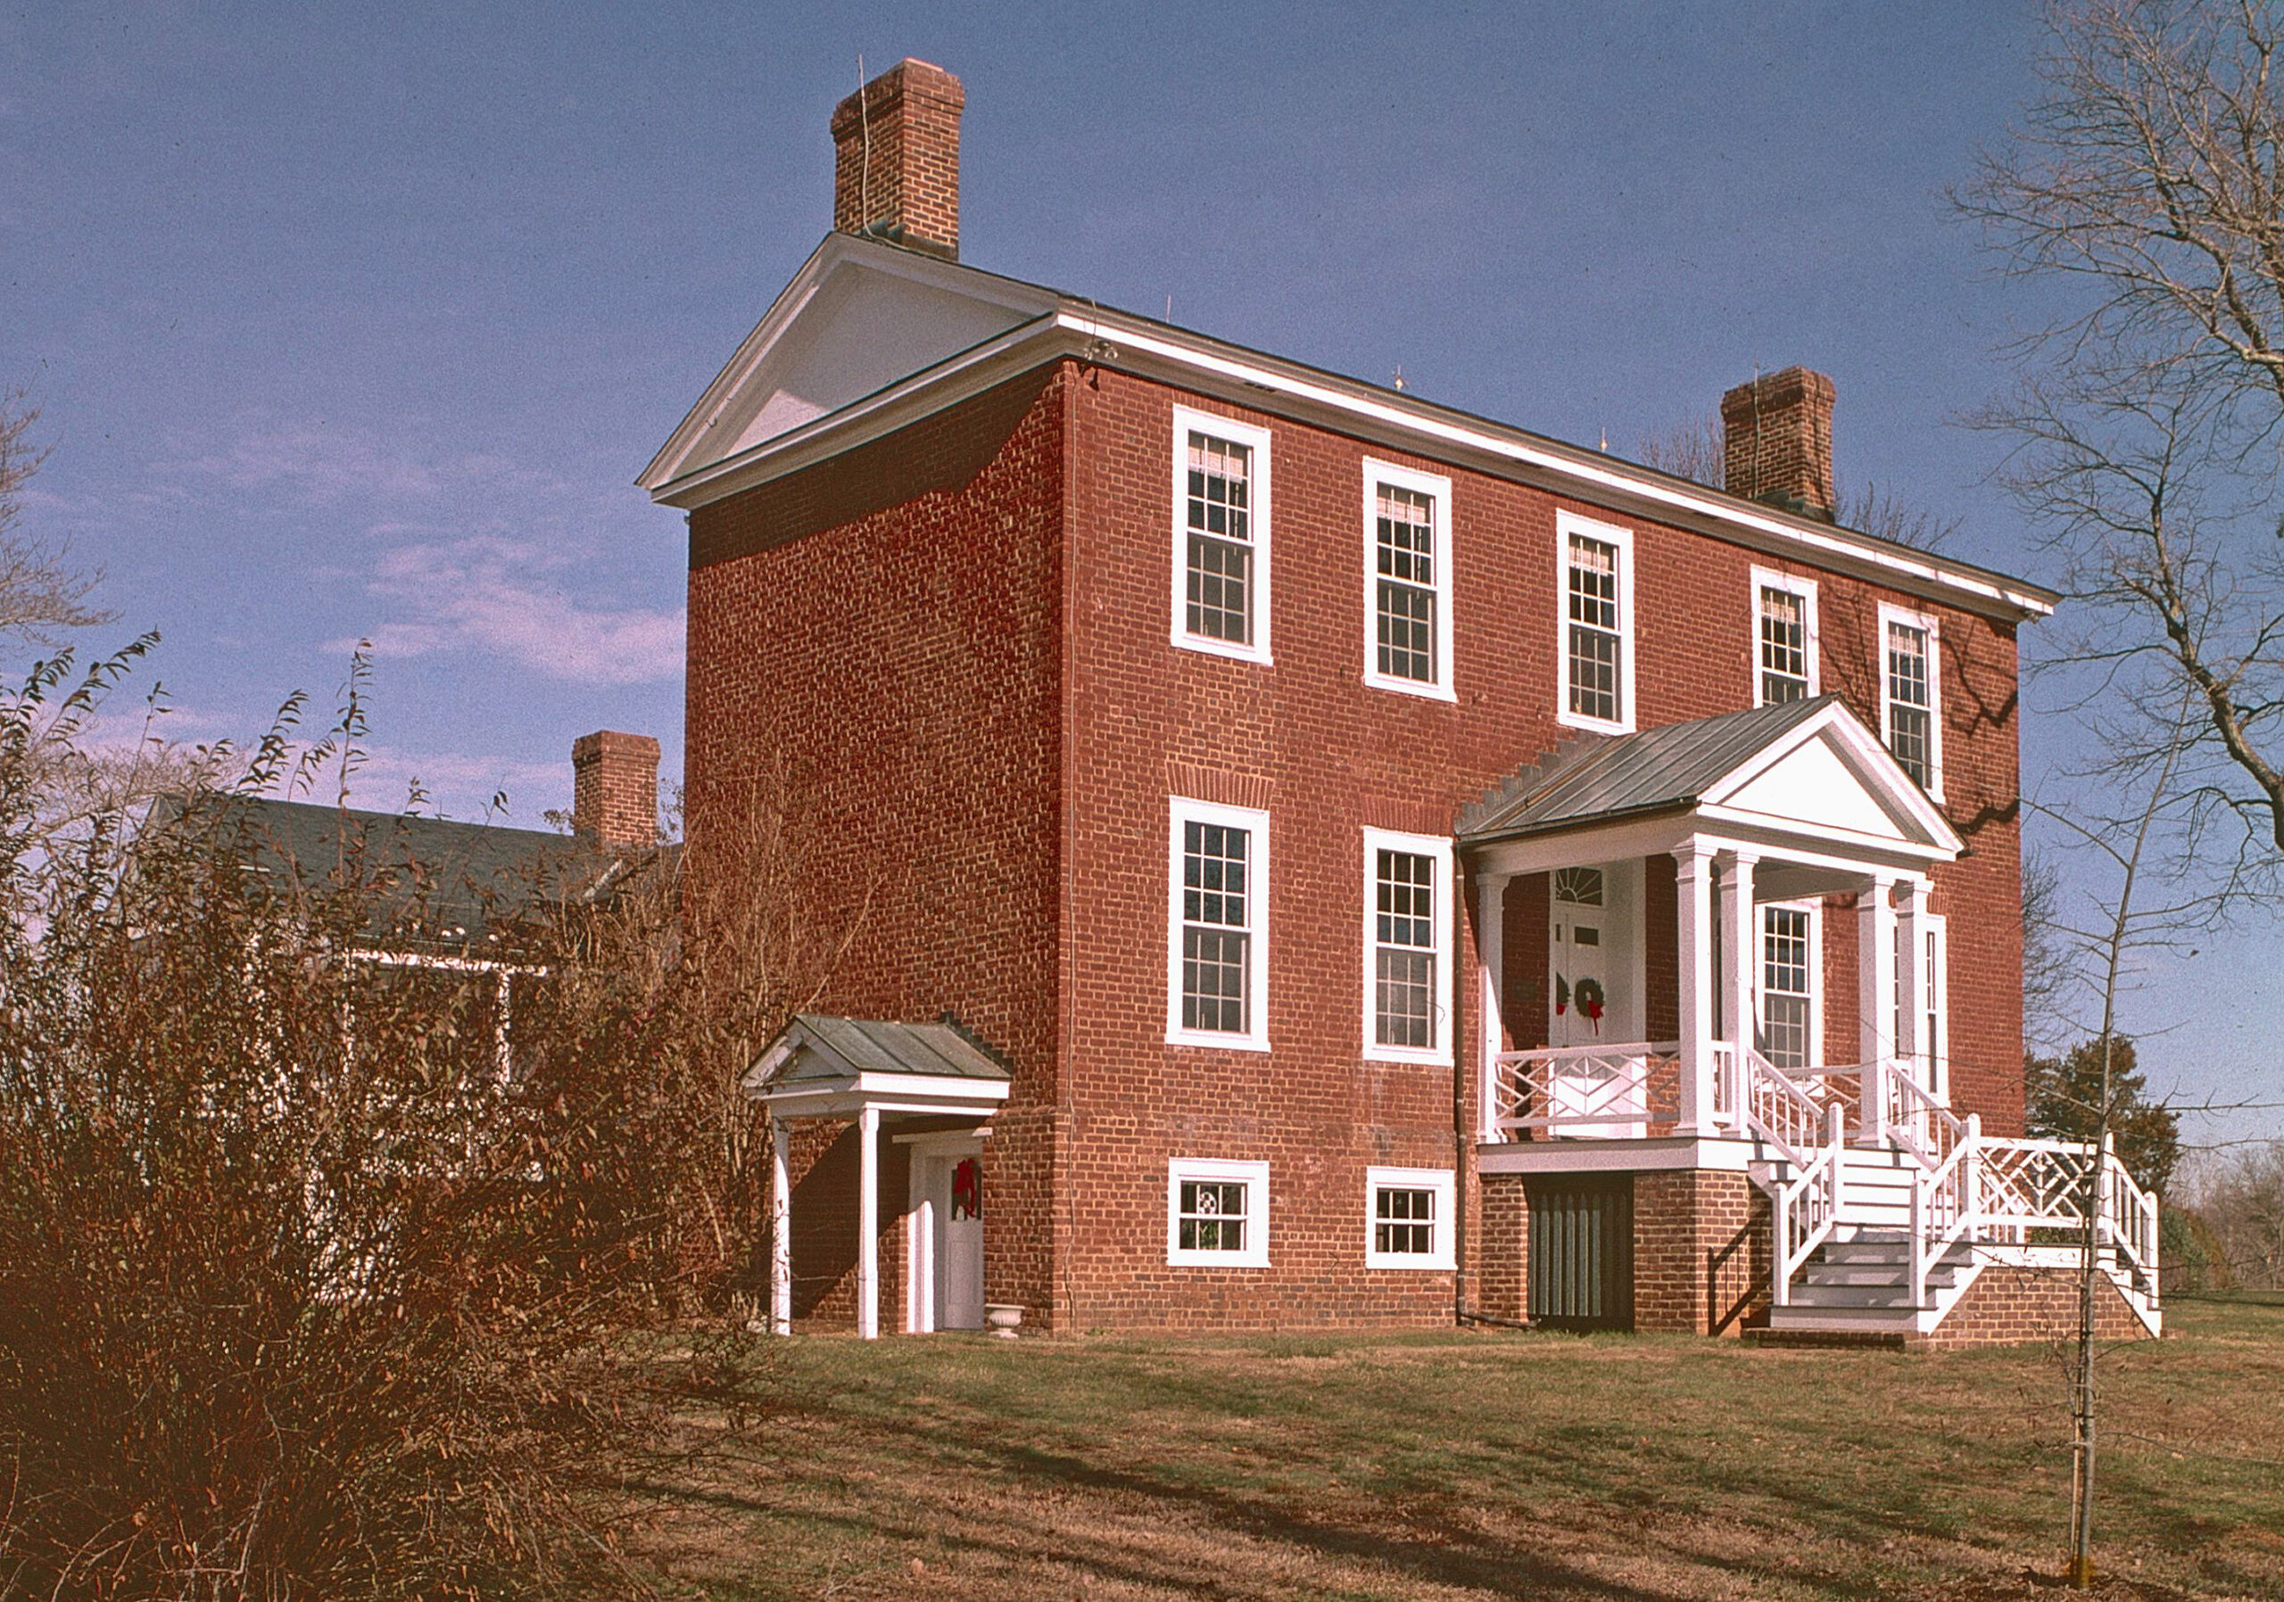
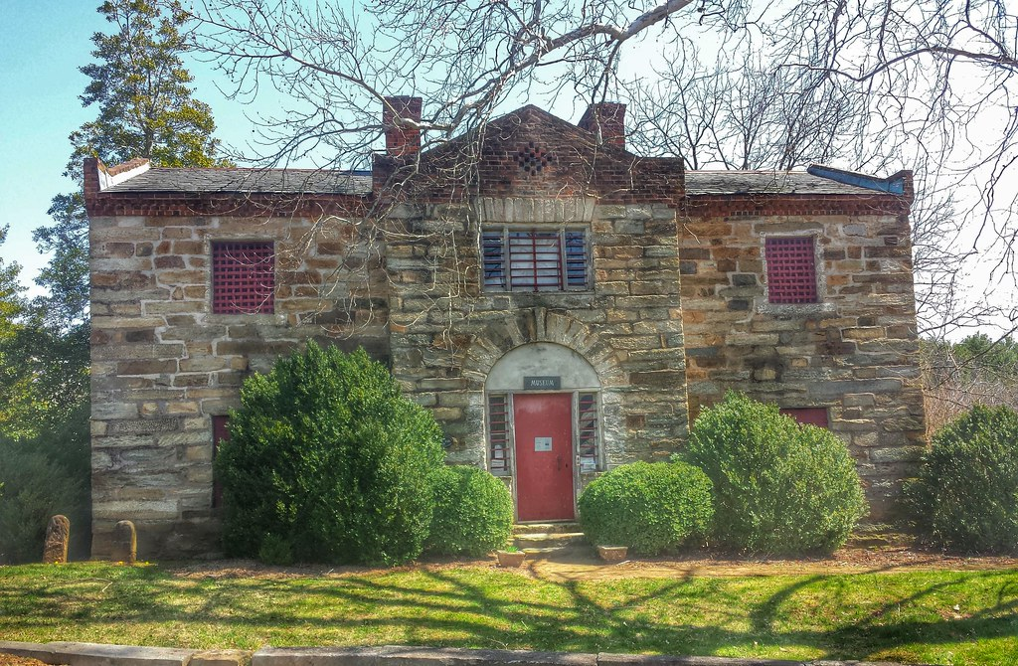

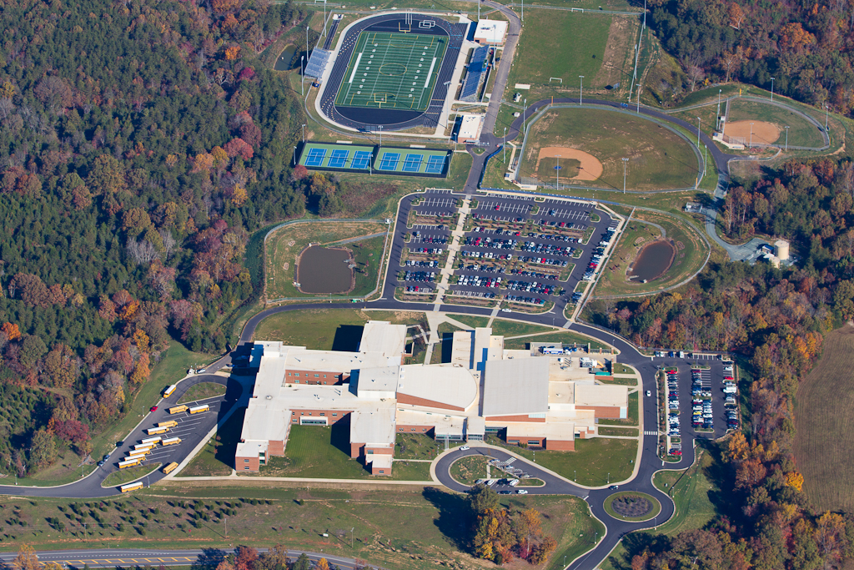
QUESTIONS ABOUT PRESENTATION

Slide 10
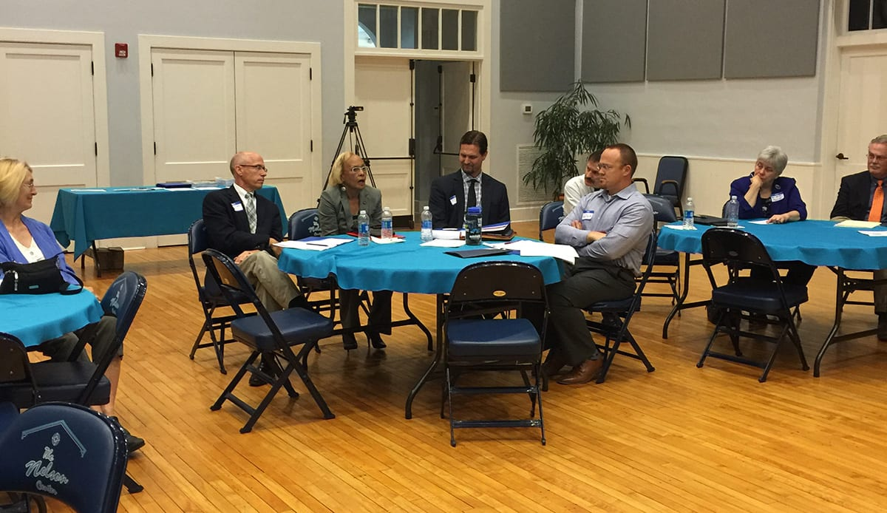
NOW WE WANT TO HEAR FROM YOU
Group Exercises
P.A.R.K. Exercise
Mapping
Ground Rules:
These exercises are for
discussion, not debate.
Success depends on participation.
Stay on topic.
All ideas are valid.
Respect each other’s thoughts/ideas.
Disagree without being disagreeable.
THIS IS NOT A PUBLIC HEARING. THIS IS A PUBLIC INPUT SESSION.

